Slide 1

IT Ticket Support Analysis
Presented by: Akhil Chauhan
Date: October 23, 2025

Slide 2
Problem Statement — Why IT Support Team Struggle to Maintain Speed and Satisfaction
Context:
Between 2016–2020, ticket volumes in the IT Support system increased significantly, placing greater pressure on agents to resolve issues efficiently while maintaining user satisfaction.
Problem:
Despite rising workloads, resolution times and satisfaction levels→ little to no improvement.
It remained unclear whether performance issues stemmed from:
• Manpower gaps — need to hire more agents,
• Skill gaps — need for training and upskilling OR
• Tool/Software limitations — need for better ticket management systems

Slide 3
Project Aim - Finding What Drives IT Support Efficiency
This project aims to:
🔹 Analyze multi-year IT ticket data to assess performance trends.
🔹 Identify key factors influencing agent efficiency and customer satisfaction.
🔹 Recommend actionable improvements in People, Process, and Technology.
🔹 Guide management in future training, hiring, and software investment decisions.
“Automation can resolve up to 22% of IT service-desk tickets at almost zero cost, reducing workload and freeing agents for higher-value tasks.”
Project analyzes five years of IT support data to identify where improvements or investments are most needed.
OBJECTIVES:

Slide 4
Understanding the Dataset — IT Support Tickets (2016–2021)
Key Data Points:
97,500 IT support tickets from 2016–2021, covering Hardware, Software, System, and Login Access categories.
Includes resolution time, satisfaction rating, request type, and assigned agent.
50 agents included with derived demographic fields.

Slide 5
Data Cleaning & Preprocessing:
Standardized dates into Year–Quarter format for time trend analysis.
Fixed missing/inconsistent entries using Find & Replace and validation rules.
Added new fields such as Efficiency Score, and performance categories (High/Normal/Low) for analysis.
Data Preparation:
Categorized agent metrics into High/Normal/Low, created Efficiency Score.
Used Data Validation rule, and Functions like UNIQUE, ISDATE, IF etc. to ensure clean data

Slide 6

Analysis Conducted:
Trend Analysis → Ticket volumes, satisfaction, and resolution times over years/quarters.
Efficiency Analysis →To evaluate team performance
Decision Matrix Analysis → Classified agents into Training, Hiring, or Software Upgrade categories.
Demographic Analysis → Grouped agents by age brackets.
Comparative Performance Analysis → Individual Agents Performance
Category-wise Analysis → Evaluated KPIs across request categories.
Tools/Technologies:
Used both Google Sheets and Microsoft Excel
Pivot Tables, Charts, XLOOKUP/ PERCENTILE /IFS,
Slicers for interactive filtering

Slide 7
Analytical Framework — Exploring IT Support Performance
Three core dimensions analysed:
1️⃣ Ticket Dynamics
Analyzed ticket trends, categories, and severity to identify workload patterns and bottlenecks.
2️⃣ Tool & Team Efficiency
Evaluated current software and processes through trends in resolution time, satisfaction, and efficiency score.
Helped determine investment priorities — software, training, or hiring.
3️⃣ Agent Capability
Compared performance by age group to assess skill, experience, and workload balance.
Goal: Identify which factors — issue type, tool effectiveness, or agent capability — most impact overall IT Support performance.

Slide 8
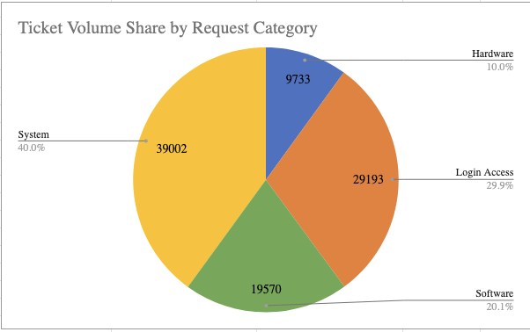
Ticket Volume by Request Category
Key Insights:
Dominant Category: System issues (40%) form the largest workload→ top priority for optimization.
Critical Recurring Problem: Login Access requests (30%) are highly frequent
Together, System + Login Access = ~70% of total workload → priority focus areas.
We’ll look at other 2 KPIs (Avg. Satisfaction Rate and Avg. Resolution time) to finalise the our decisions.

Slide 9
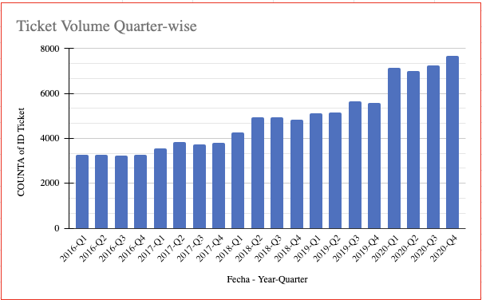
Ticket Volume over the Years
Key Insights:
Steady Growth: Ticket volumes grew consistently from ~3,200 in 2016 to ~7,600 in 2020.
Sharp Surge (2019–2020): Significant spike (~35% increase) in 2019–2020
Operational Pressure: Higher volumes may strain agent capacity
Future Outlook: If the trend continues, scaling workforce or enhancing automation tools will be critical to sustain service quality.

Slide 10
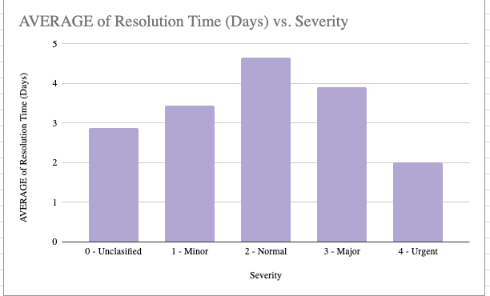
Correlation b/w Severity & Avg. Resolution Time
Key Insights:
Unexpected Delay in Normal Cases: Normal severity tickets take the longest (avg. 4.66 days)
Prioritized Resolution for Critical Issues: Urgent cases are resolved fastest, showing effective prioritization.
Balanced Effort in Mid-Tier Issues: Minor and Major tickets (3.4–3.9 days) reflect moderate handling times.
Correlation Insight: Higher urgency generally → quicker resolution, but “normal” tickets may be neglected, impacting overall service perception.

Slide 11
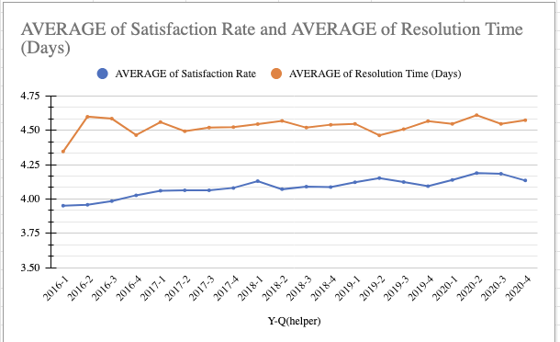
Decision Making for Investment
Observations:
Ticket count → a sharp rise (~35%) between 2019–2020.
Despite higher workload, average satisfaction remained stable (~+0.97%).
Resolution time did not improve — in fact increased (+1.07%), countering the idea of a software upgrade.
Efficiency score rose ~34%, driven almost entirely by ticket volume growth.
Tickets per agent ↑ ~34.9% between 2019–2020 → workload absorbed without additional staff.

Slide 12
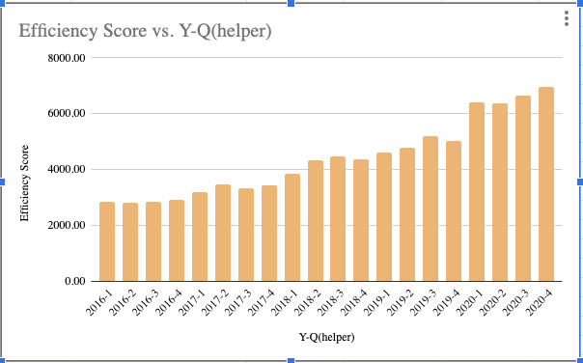
Agents were upskilled/trained to handle more volume, with no major decline in satisfaction.
Since resolution time did not drop, software upgrades were unlikely.
Workload was absorbed, hiring more agents is not justified.
Now, an Agent-level analysis was done. Decision matrix made.
  Frequently pointed to Training as corrective action. Fewer recommendations for Hiring or Software.
Investments should be directed towards Training/upskilling, not new software or more hires.

Slide 13
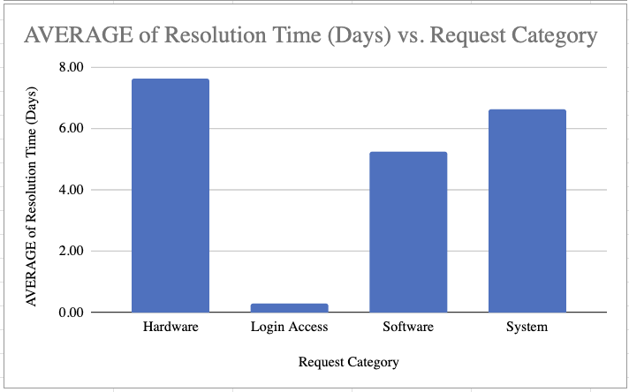
Category-Wise Ticket Performance
Key Insights:
System tickets dominate volumes (~40%) → System-related bottlenecks are the biggest drag on efficiency.
Hardware tickets take longest (7.6 days avg) but are only 10% of total volume → overall operational burden is smaller.
Software tickets (5.2 days avg, ~20% of volume) → Not as numerous, but still a sizeable contributor to delays.
Login Access tickets are near-instant (0.3 days, low variability) → This shows automation works. It sets a benchmark for what is possible.

Slide 14
Satisfaction scores remain stable (~4.1 across categories) → Improving resolution times is likely to boost efficiency and agent morale, more than customer sentiment directly.
Insights:
System & Software = Top investment priorities → Largest stress points for both agents and operations.
Invest first in System & Software (automation, process redesign, tool upgrades).
Hardware = Secondary investment → Volume is lower, but extremely long resolution times damage user trust
Login Access = Model of success
Satisfaction stability is deceptive → Scores look fine now, but as workload stress builds, agent burnout or outlier delays could push satisfaction down.

Slide 15
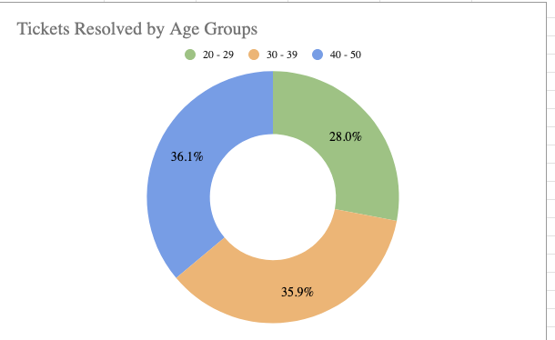
Performance Analysis by Age Group of Agents
Key Findings:
Group A (20–29 yrs):
  Fastest resolution (4.47 days), highest satisfaction (4.23).
  Lowest ticket volume (~27k) → efficient but lighter workload.
Group B (30–39 yrs):
  Worst performer: longest resolution time (4.68 days), lowest satisfaction (3.99).
  Still handle ~35k tickets → high volume + poor quality = inefficiency.

Slide 16
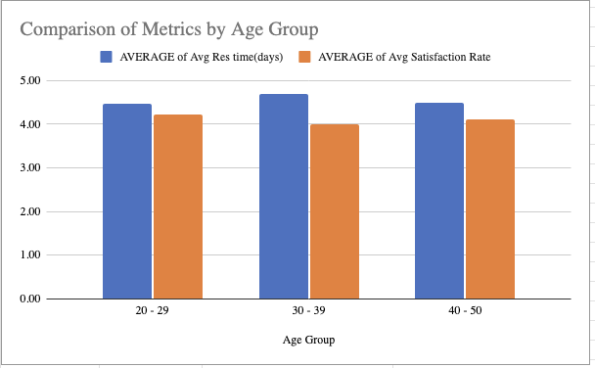
Group C (40–50 yrs):
  Heaviest workload (~35k tickets).
  Resolution steady (4.48 days) and satisfaction moderate (4.11) → balance between volume and quality.
Insights:
Group B shows signs of inefficiency/burnout → high workload but weak performance.
Group A shows promise → fast, high satisfaction but need gradual exposure to more complex cases.
Group C demonstrates resilience → handling largest share with balanced performance.

Slide 17

Strategic Recommendations
1. Prioritize Training & Upskilling
Why: Efficiency score trends + tickets/agent growth show performance gains came from agents handling more tickets, not faster resolution.
Action: Expand structured training/upskilling programs.
Impact: Boosts efficiency, reduces resolution delays, sustains quality without increasing headcount.
2. Targeted Tech Investments
Why: Category analysis shows System (39k tickets, 6.6 days avg) and Software (19k tickets, 5.2 days avg) are bottlenecks. Hardware also slow (~7.6 days).
Action: Invest in automation/tech tools for System & Software, replicate Login Access success (fastest resolutions).
Impact: Lower backlog, reduce variability, improve resolution time consistency.

Slide 18
3. Demographic-Specific Interventions
Why: Mid-career agents (30–39 yrs) underperform → longest resolution time, lowest satisfaction, despite handling large workloads.
Action: Provide focused training + workload rebalancing for this group. Gradually increase workloads for younger agents (20–29 yrs). Support senior agents (40–50 yrs) with tools to sustain heavy ticket volumes.
Impact: Balances efficiency across workforce, reduces burnout, maintains service quality.

Slide 19
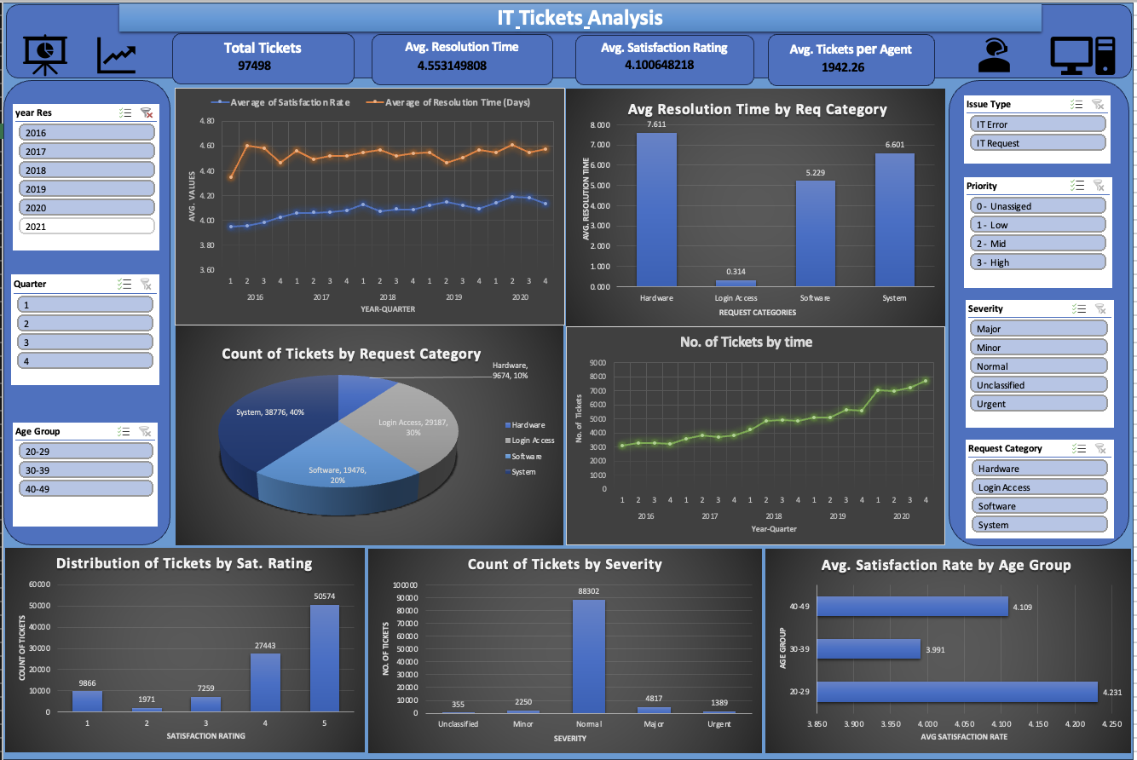
Dashboard

Slide 20
Conclusion
IT support operations show steady performance but also reveal clear bottlenecks that impact efficiency and customer experience.
The analysis highlights that training and upskilling agents is the strongest lever for driving long-term improvement.
Targeted technology investments in key areas can further reduce inefficiencies and replicate the success of automation seen in simpler processes.
Overall, a combined strategy of capability building and smart tech upgrades will enable IT support to handle growing ticket volumes effectively, maintain customer satisfaction, and strengthen long-term resilience.

